Slide 1
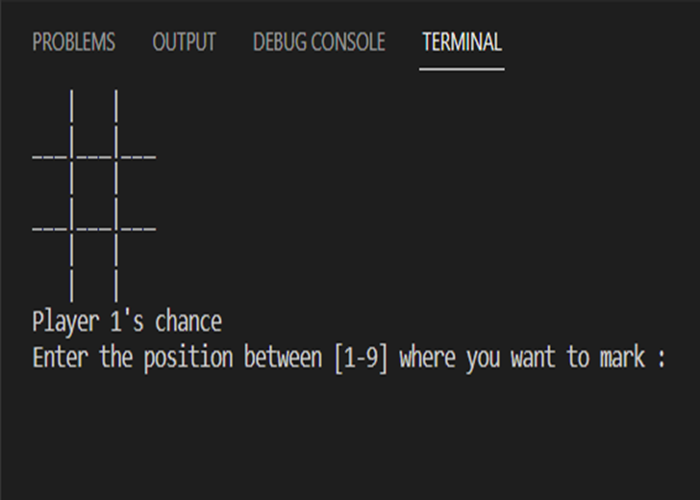
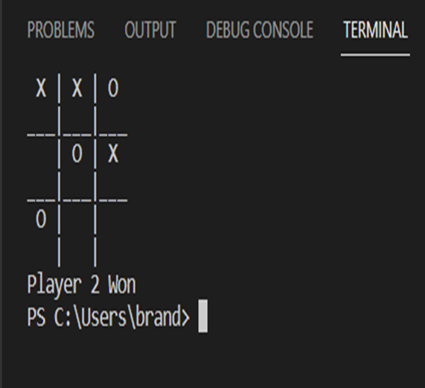
Tic-tac-toe game
BY: Brandon Richards
This is a simple game of Tic-Tac-Toe created using a “drawboard()” function and you mark your position on board using keys 1-9.

